Slide 1

Web Development Training and Placement Cell
BY Shivham Singh and Harish Chandra Das

Slide 2
T&P Info Page Placement is the most important phase of an undergrad student's life. Being able to follow upon the events can help the student be prepared in advance.
● This web app shows all upcoming, previous and ongoing companies separately
● Each company has a detailed description which can we viewed on clicking
● Has the ability to add, delete or update companies
● The data is persistent
● Gives only the admin privilege to add, delete or update companies

Slide 3
Technologies used:
Bootstrap
Html
Css
Php
mysql

Slide 4
Sources:
Mdn
W3schools
Colourhunt
Codeply
Stack overflow

Slide 5
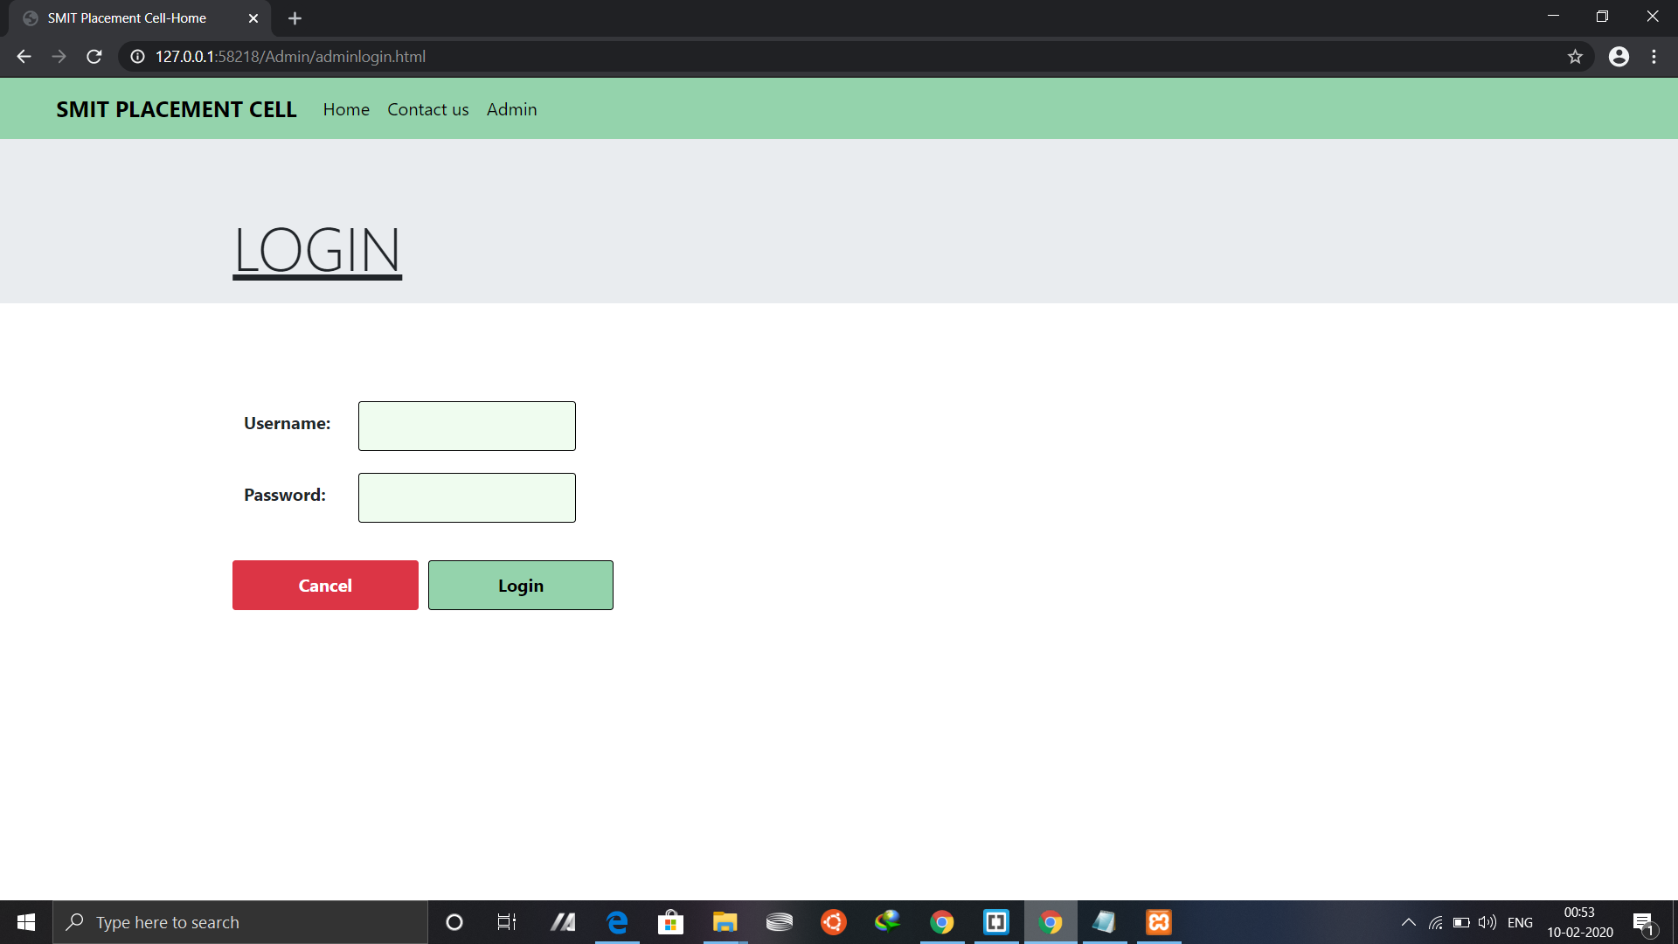
00

Slide 6
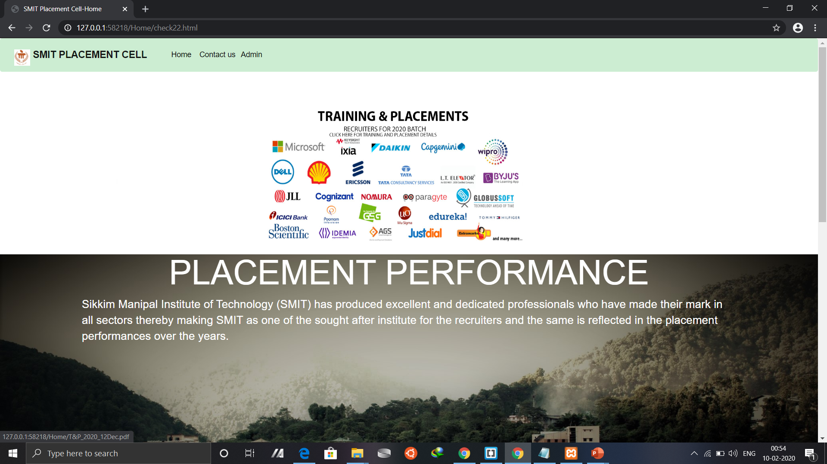

Slide 7
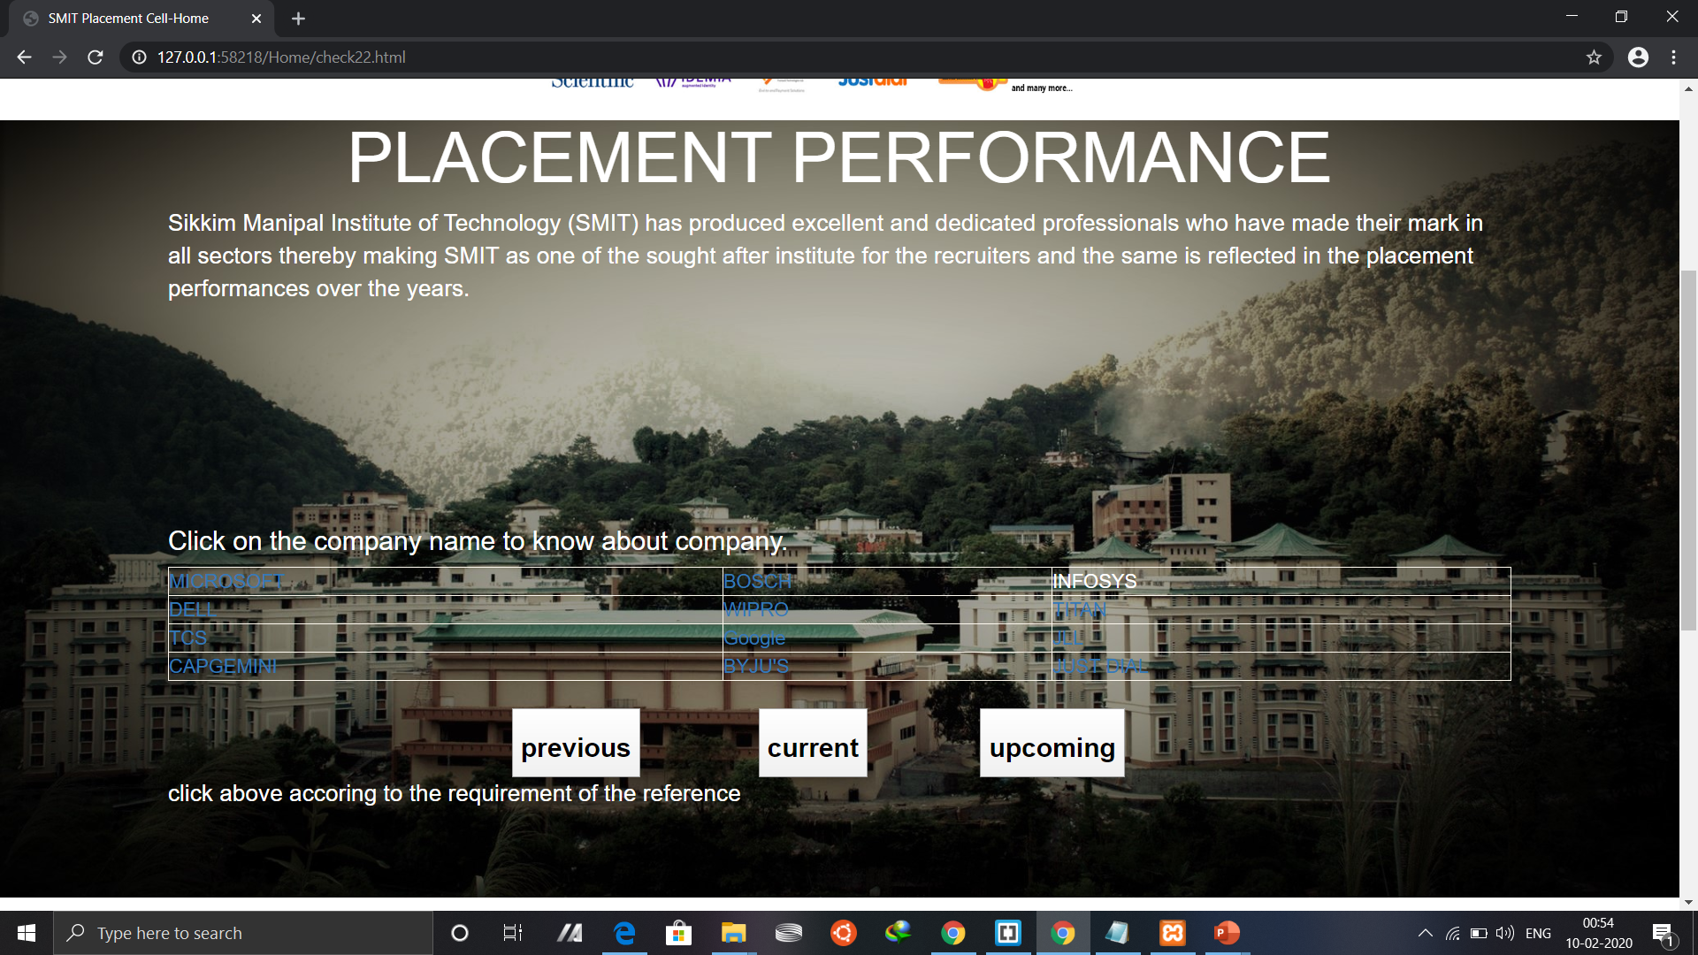

Slide 8
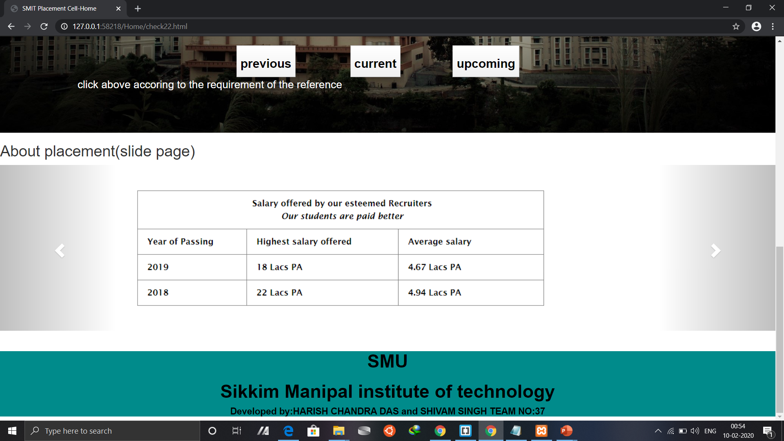

Slide 9
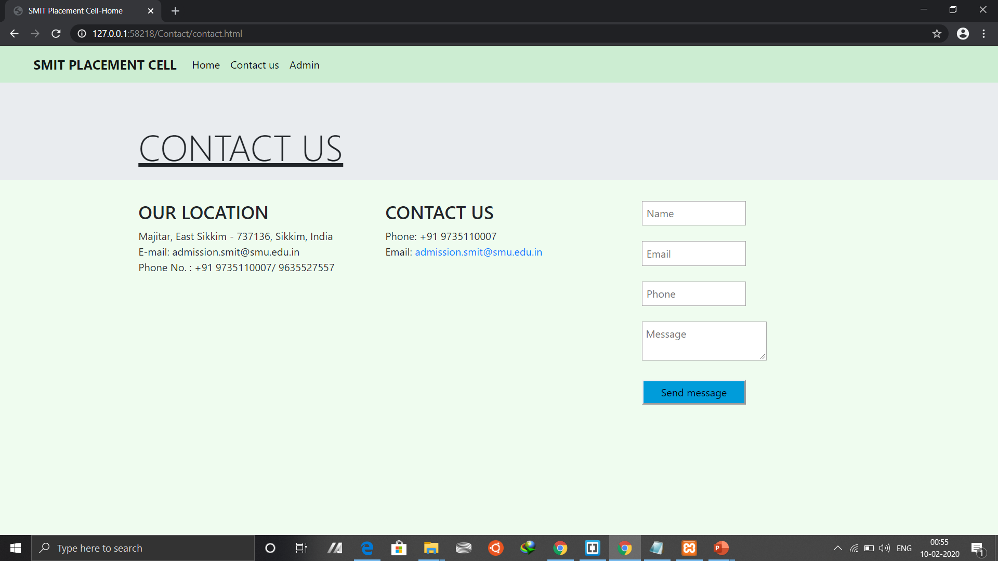

Slide 10
